Slide 1

ELECTIONS WORKSHOP
Introduction to campaigning

Slide 2
What’s on the agenda?
Develop your skills in running in an election
Give campaign planning a go
Discuss the benefits of running
Answer your questions

Slide 3
Elections Timeline
Nominations Period
Campaigning Period
Voting Period
Results
Open Tuesday 24th January, 12:00
Close Tuesday 21st February, 12:00
Online campaigning from close of nominations
Physical campaigning from Thursday 2nd March
Monday 6th March 12:00
Thursday 9th March 12:00
Thursday 9th March (Time TBC)

Slide 4
What is campaigning?
Campaigning is simply communicating to as many people as possible and showing them why they should vote for you
Campaigning = votes

Slide 5
Effective campaigning – Plan
Figure out what you are saying and when
Who are you targeting? At what times?
Do you know where you and your team need to be?

Slide 6
Effective Campaigning – Getting your message out
Define your key support demographic
Who do you have the backing of?
  Your course, groups you’re in, etc.
  How can they help?
Lecture shouts
  Be practical
  Use your team to spread out your voice

Slide 7
Online & Physical Campaigning Tips
Online Campaigning
Schedule (but be flexible)
Be inventive and fun
Keep your tone/design consistent
Use the right links!
Be sensible – is messaging people at 2am really a good idea?
Physical Campaigning
Talk to everyone
Get your pitch down
Don’t be upset when people reject you
Tailor your message based on the audience
Whatever you do, DON’T BREAK THE RULES!

Slide 8
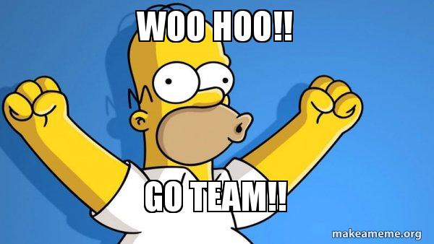
Looking after your team
What’s the purpose of the team?
  Get you pumped
  Be a sounding board
  Support you through the week (and results)
  Spread the message
NB You are responsible for your team
  Make sure they know the rules
  Say thank you!

Slide 9

Looking after yourself
Plan when your campaigning will be most effective
Take time off
Don’t let it get you down
EAT REAL FOOD!
Delegate to your team

Slide 10

Positive Campaigning = Good Campaigning
Don’t get caught up in the #drama
Don’t break the rules
Focus on your campaign, not what other people are doing
Don’t be mean
Respect voters’ opinions and actions
Ask for second preferences

Slide 11
Benefits of campaigning
Good experience
  If you win, you will be involved in high-level decisions both in the Union and the University
  If you don’t win, you can still experience in planning and delivering a campaign
Could get a job
Chance to stand up for what you believe in and make a difference
Valuable networking
Could springboard your career
Got nothing to lose!
Candidates go on to do great things

Slide 12

What now?
Get your nomination in!
  The deadline is midday Tuesday 21st
Get your campaigns team together!
Get ready to rock your campaign!
Come along to training post-nominations
Ask any questions you have

