Slide 1
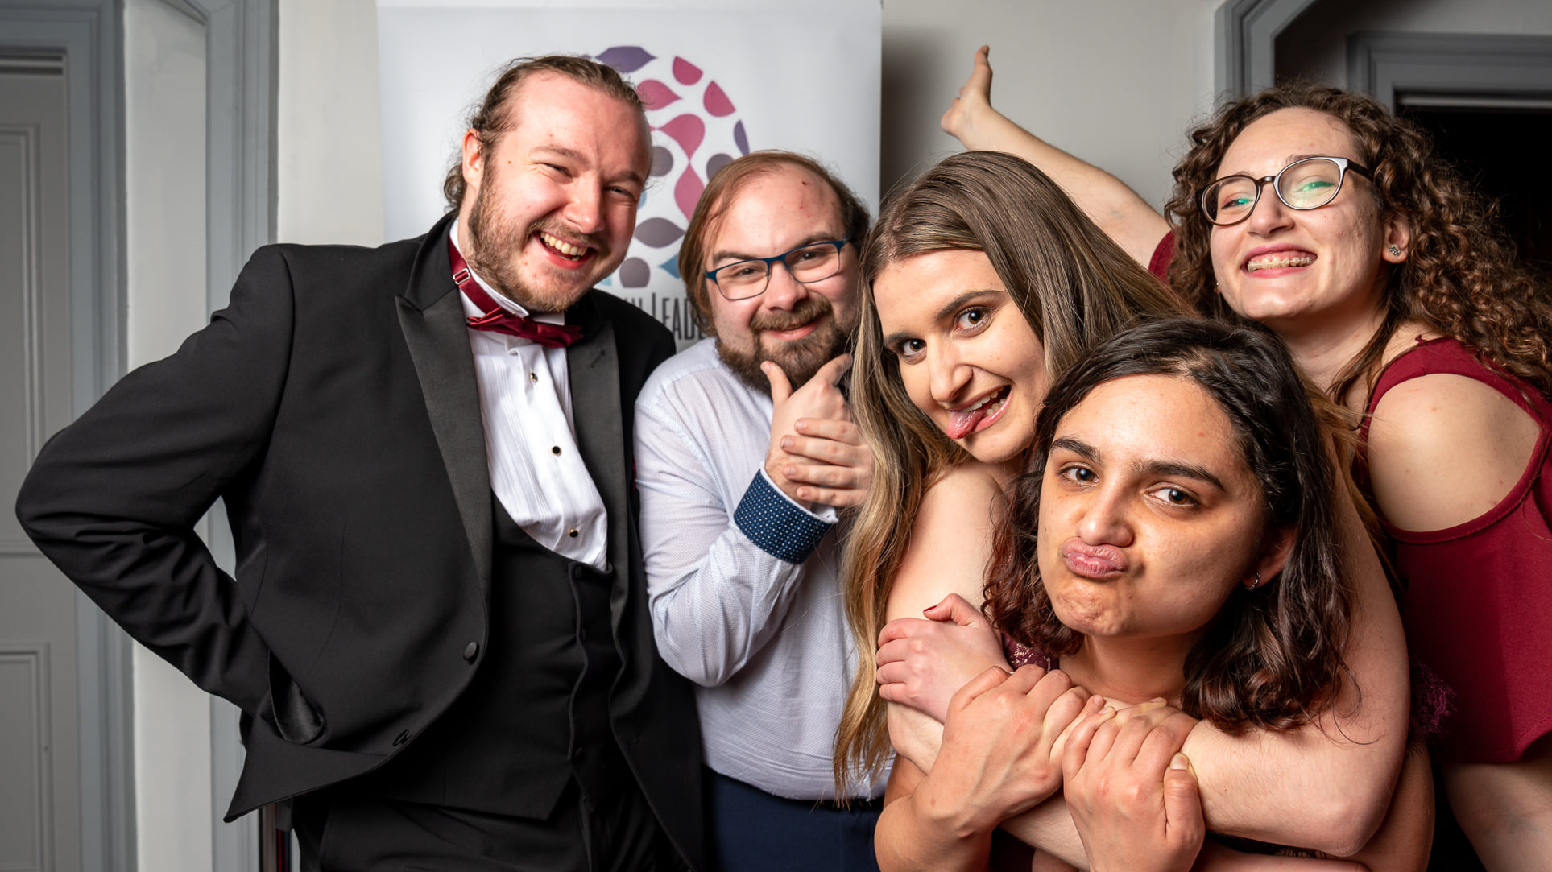
Societies AGM
16th March 2022

Slide 2
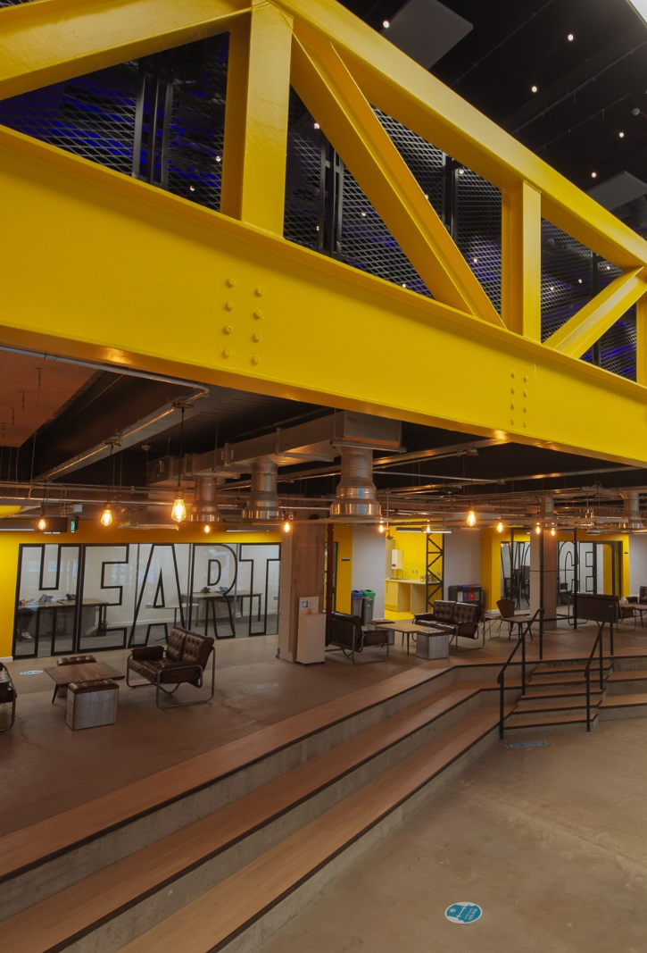
Before we begin
Please send one message with-
Your name;
Your DS username; AND
The society/ies that you are representing
To Jenny Thomson in the chat

Slide 3
Agenda
Fundraising for your society
STAR Awards
Charity Month- the Winners!
Socs exec candidates
Active & Engaged
Vote for socs exec; Ask Societies Exec
AOCB
Finances
Alumni Fund
Soc AGMs, handover, re-affiliations

Slide 4
Alumni Fund
Spring Application Process is OPEN
Elaine Keil
Alumni Fund Officer

Slide 5

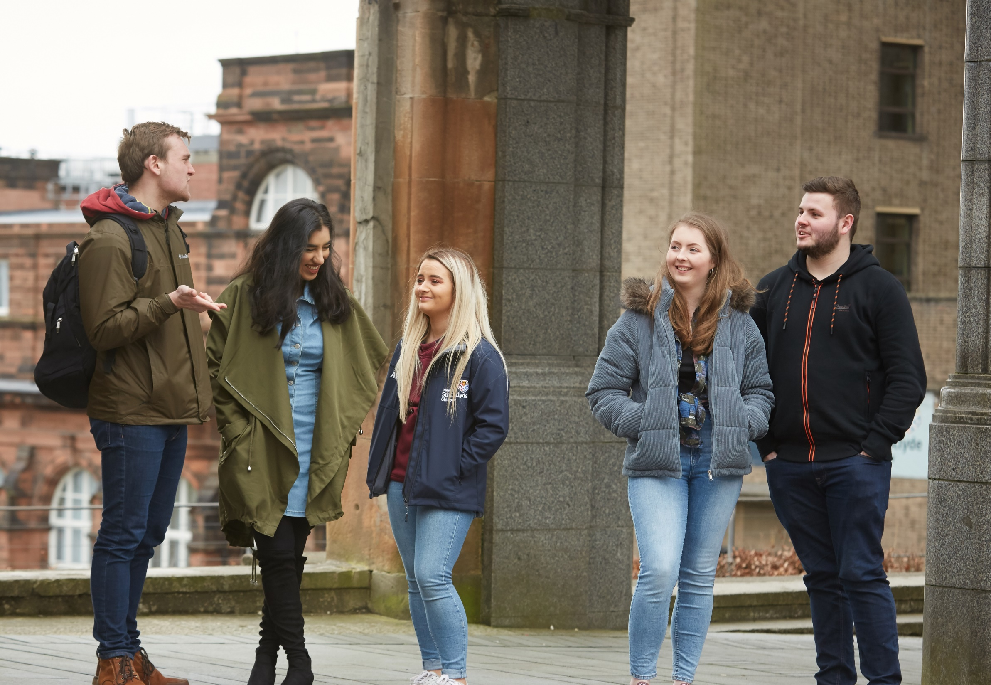

Alumni Fund

Slide 6
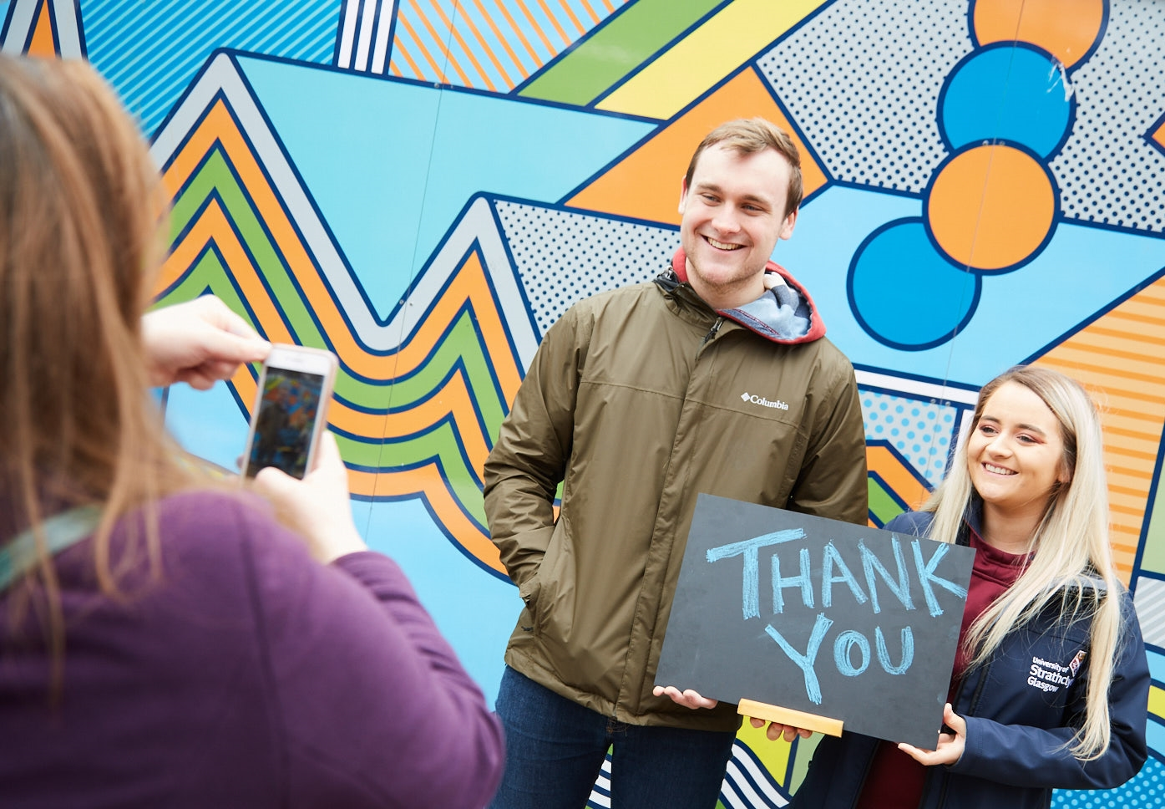
The Alumni Fund is funded by donations from our alumni community. We raise around £300,000 each year to distribute to two core areas of university life:
Undergraduate Scholarships: making it possible for students from less advantaged backgrounds attend Strathclyde.
Enhancing Student Experience: clubs, societies and projects that enhance students’ overall university experience.

Slide 7
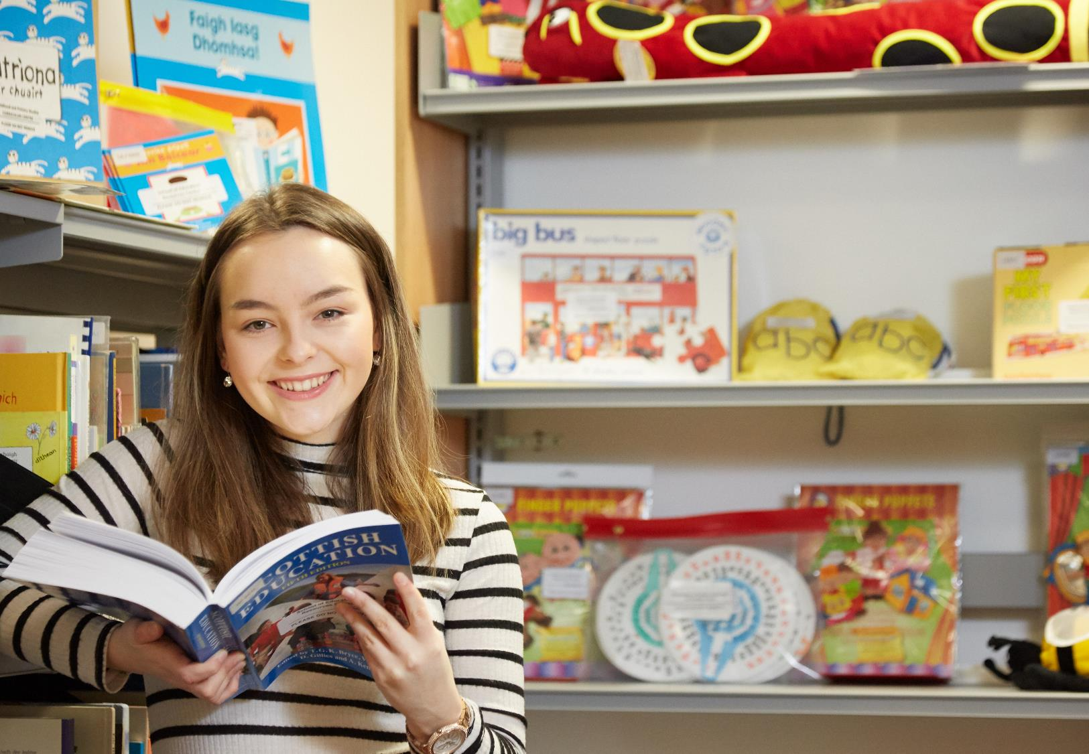
Applications must be student-led, from an affiliated club/society or university department and meet one of these priorities:
Widening participation
Outstanding student experience
Engaged and internationally aware students
Develop graduates who are engaged, enterprising, enquiring and ethically, globally and culturally aware
High quality learning and teaching

Slide 8
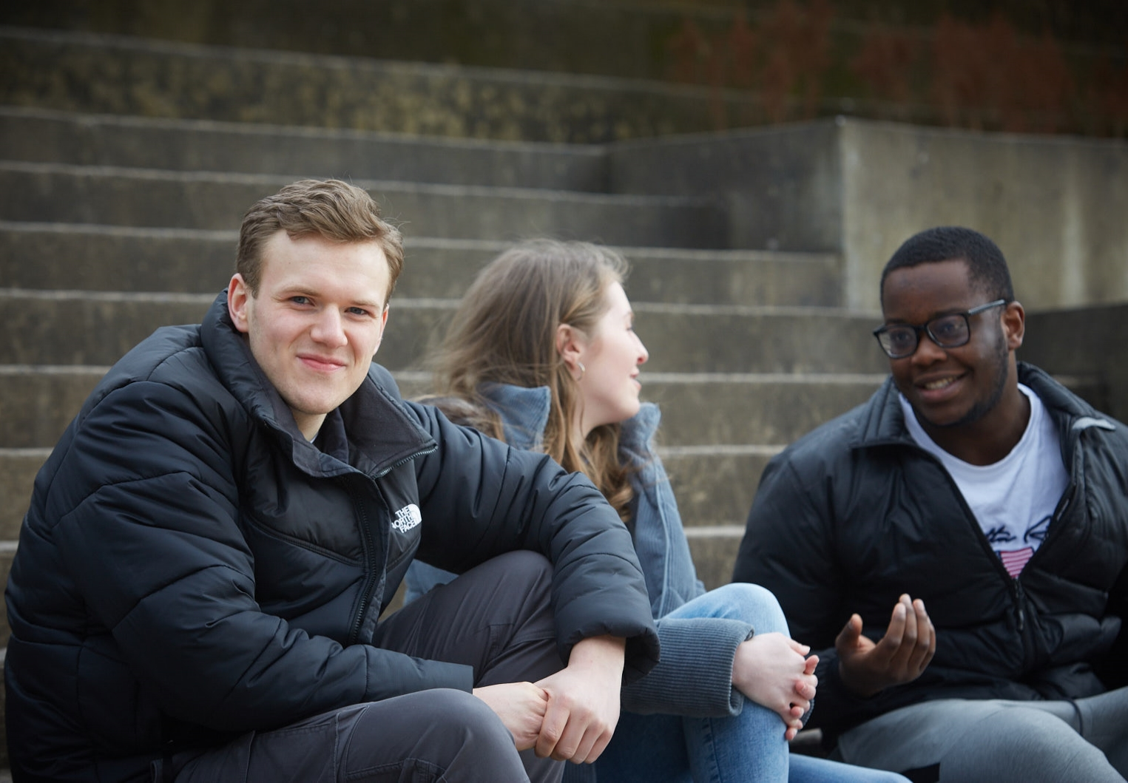
Application process:
Read the guidance document
Complete the online application form
Include a budget
Submit before 10th April
Funds are awarded in June
Report on your project Spring 2023
Second round of funding opens in Autumn

Slide 9
Apply online now
https://www.alumni.strath.ac.uk/alumni-fund-applications
Any questions?
developmentoffice@strath.ac.uk

Slide 10
Socs Exec Candidates
Hear from the candidates, their experience and why they would like to be on the Societies Executive Committee for 2022/23
Use the time between hearing about the candidates and voting to decide who is going to vote on behalf of your society and how you’re going to vote
You rank select candidates in preferential order from 1-6. REMEMBER: each SOCIETY gets ONE vote

Slide 11
Benn Rapson
Current committee(s): Podcast Society, Student Executive Committee
I've been involved with the Union for the last 5 years. Within my first few weeks at Strath, I established my first society. By my third year I was a society committee member on 5 societies and that same year I was lucky enough to serve on the Societies Exec (known as Clubs Exec in 2019/20). Societies Exec is one of the most impactful committees within the Union. With its grant gifting powers it makes a really positive contribution to the student experience. Having been involved with Societies Exec in the past I'm keen to get involved again and bring my experience to the table for the benefit of all of our societies. Ultimately, I just want to play a part in making sure we all have a fun time - especially following the last couple of years. I believe I have the experience to make a positive role on this year's committee. My role as a Union Executive Officer for the last two years has given me valuable insight into potential routes for societies to gain external funding support in addition to our own internal grants process. I want to maximise every available penny for our societies so they can thrive and make student life better for all at Strath!

Slide 12
Emma Reavey
Current Committee(s): Women+ in Leadership Network, Podcast Society, Societies Executive Committee
This year I have sat on Societies Exec and really enjoyed it. Working with the team to find a way for our budget to meet the needs of as many student societies as possible has been a fantastic experience and I would love the opportunity to do the same next year, encouraging more collabs between societies, another great charity month and utilising our social media to communicate more with committees!

Slide 13
Haroon Zaka Tarar Muqadas
Current committee(s): Fusion Radio; Debating Society; Strath TV
From the moment I joined Strathclyde, societies have played a huge part of my university life. I'm an active member of more societies than I can count on my hands, being part of 3 of those societies' committees. So, societies are very important to me, and I want to make sure they can continue to provide the best experience to all students in Strathclyde. I think I would make a good addition to the exec because of how devoted I am to getting people involved and improving the societies experience for everyone.
Notes:
Not attending the AGM

Slide 14
Ioannis Falkonakis
Current Committee(s): Debating Society, Strathclyde University Naval Architecture Society (SUNAS)
I am the president of the debating society
I am treasurer of SUNAS
I love societies
I live executives
Win

Slide 15
Jamie Campbell
Current committee(s): SU Commuting Society, Strath Mary's Meals, Strath Zine, Journalism Society
My first year at university began during the pandemic. It wasn't until my second semester that I decided to join a society, the Strath Mary's Meals society which I later became part of the committee on. Joining a society allowed me to make such a fantastic group of friends and it also helped build my confidence and allowed me to have some social ability in a time that severely hindered it. Joining committees has been both fun and hard work. It's meant I've had some amazing experiences that I felt I wouldn't have had I not joined the committees. Honestly, it's really made me feel impassioned towards the work I've done with the committees and has made me feel like I've made a difference. I want to be on the societies exec committee because I want to make even more of a difference than I already have. I know firsthand how important societies are in students lives and how beneficial they are. Societies are a great place for students to make friends, have amazing experiences, be expressive, be heard and feel more included. They allow everyone to find or have a place and if I can help in that process in any way, shape or form I would love to. I think I should be elected onto the socs exec because I really do believe I can help make a positive difference. I really want to get involved with the Union and as I've said before I really do want to help make a difference. I think the work the societies exec does is really important. Having started 3 societies, I know the hard work it takes to be a member of this committee and I really want to contribute however I can.
Notes:
Would like the chair to present on their behalf

Slide 16
Sheik Abdul Malik
Current Committee(s): SU Hot Air Balloons Society, TEDx, Societies Executive Committee
For the past two years, I have had the great privilege to serve in the former Clubs Exec and the now Societies Exec. It has been an incredibly rewarding experience to support so many amazing societies at Strath Union with their projects and activities - seeing them develop and grow both as individuals and as a group. I have seen numerous fantastic initiatives that societies have undertaken that have in turn, helped bring the entire student community at Strathclyde together. I would like to continue to use the experiences that I've gained and the knowledge that I have developed to nurture and help shape the future of societies in the next academic year.

Slide 17
Shreya Sachdeva
Current committee(s): Strathclyde Indian Students Association
For the past three years, I've been on the committee of the Strathclyde Indian Students' Association. My involvement in SISA as an active committee member has taught me various skills, most notably testing my organisational abilities and aiding in the development of my personality as a leader. I am now the Vice President of SISA. Being a part of such a large society with 187 members teaches you about the issues clubs and societies face, whether it's attempting to reach out to new people, informing them about upcoming events, or organising Q&A sessions for them. Another major SISA event is just around the corner, with roughly 300 individuals from all backgrounds expected to attend. By being nominated to be a member of the Society executive community, I hope to increase inclusivity in the strath union. With the union's fair support, I aspire for improved societal partnerships that will increase engagements with students from varied backgrounds. I am looking forward to contributing to Strath Union's diverse events, where I will be able to put my organisational abilities to use while also pursuing sustainability…

Slide 18
Socs Exec Election
HOW TO VOTE (don’t worry these instructions will appear later too)
Voting will be conducted through a Zoom poll near the end of the meeting.
Each society has one vote. The society that you are representing will be checked against all votes to ensure that two votes have not been submitted for one society.
You can select 6 candidates in preferential order. One of these is RON (re-open nominations). You need to select all 6 positions in order to submit your vote. If you select the same candidate (except RON) more than once, your vote is annulled.
If you are representing more than one society, please PRIVATE message Jenny Thomson with your candidates in order. This will be completely confidential.
If you need to, use this time between hearing about the candidates and voting to decide who is going to vote on behalf of your society and how you’re going to vote.
Any questions on voting?

Slide 19



STAR Awards!
25th of May

Slide 20
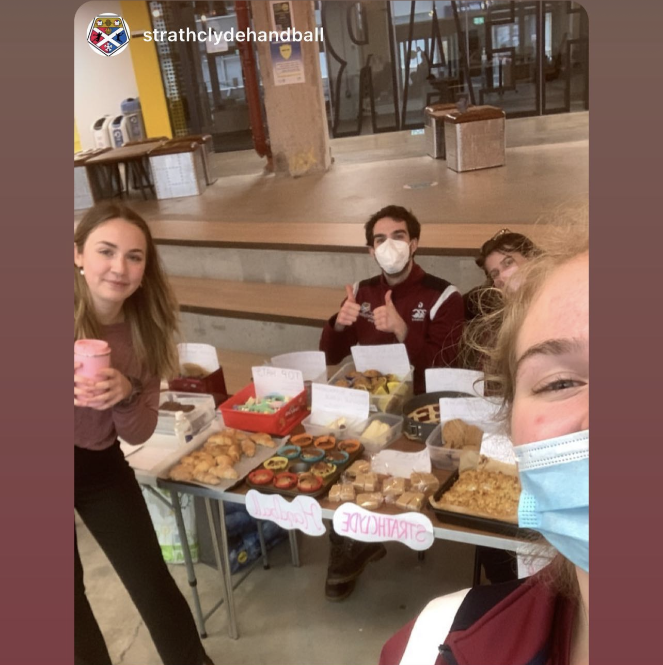





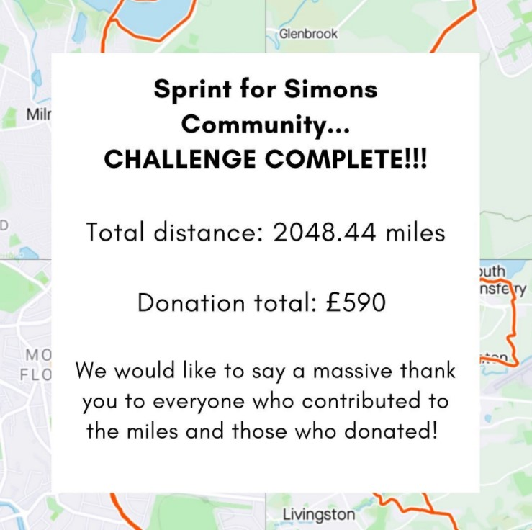
Charity Month

Slide 21
Charity Month- WINNERS
Best Society Collab
Most money raised
Best event
Book Club & Mary’s Meals
Law Society
Cocktail & mocktail society

Slide 22



Update your active and engaged status before the 1st of May

Slide 23
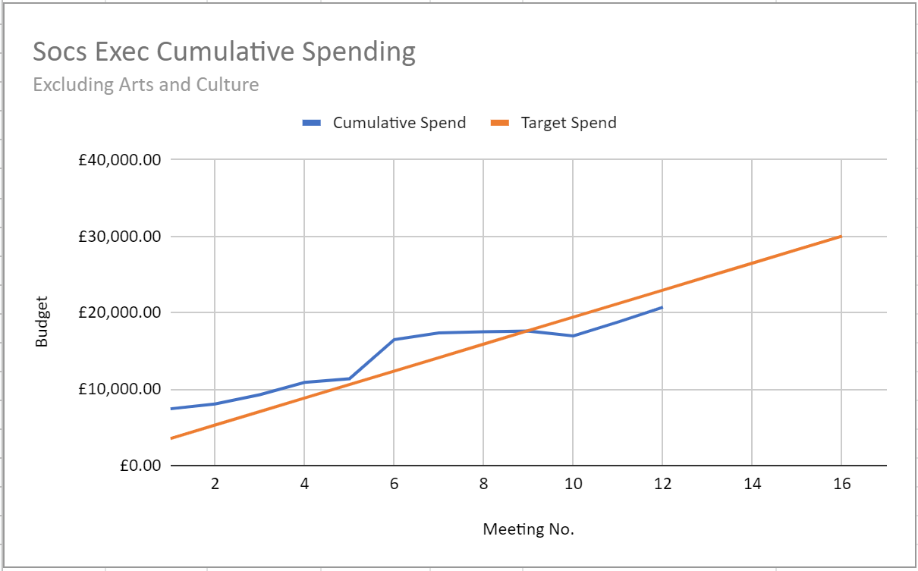
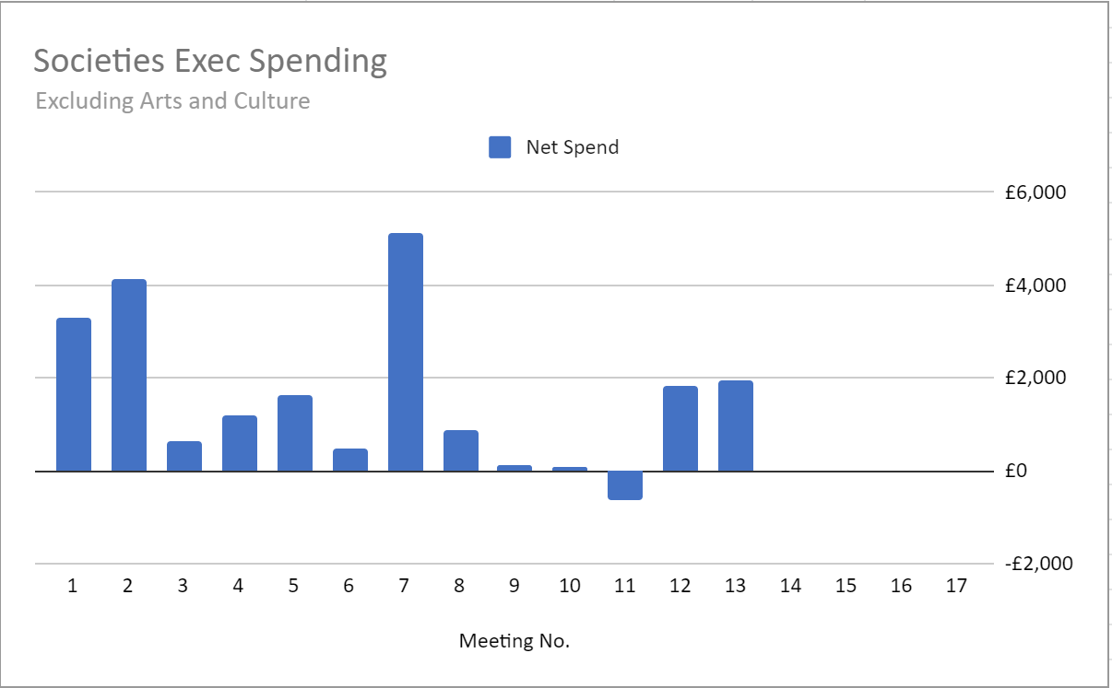
Finances

Slide 24
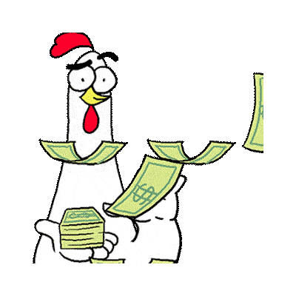
Fundraising for your society
Remember there are other avenues to get funding for your society than the socs exec grants!
Alumni funding
Complete Active & Engaged levels
External sponsorships
Get some tips on fundraising here (at the bottom of this page you’ll find advice on getting external sponsorships!)

Slide 25
AGMs, handovers & re-affiliation
Society’s AGM
  Don’t forget to have your AGM before the spring break!
  You must advertise your AGM for a minimum of two weeks beforehand
  Have a look at your AGM how-to guide
Don’t forget the importance of a good handover!
Re-affiliations open May 1st
  ALL Societies must re-affiliate for the new academic year (unless no one wishes to continue the society next year)

Slide 26
Vote for your Socs Exec 2022/23!
REMEMBER
Each society has one vote. The society that you are representing will be checked against all votes to ensure that two votes have not been submitted for one society.
You can select 6 candidates in preferential order. You need to select all 6 positions in order to submit your vote. If you select the same candidate (except RON) more than once, your vote is annulled.
If you are representing more than one society, please PRIVATE message Jenny Thomson with your candidates in order. This will be completely confidential.
Candidates (in alphabetical order of first name)
Benn Rapson
Emma Reavey
Haroon Zaka Tarar Muqadas
Ioannis Falkonakis
Jamie Campbell
Sheik Abdul Malik
Shreya Sachdeva
Other selections
R.O.N (re-open nominations)

Slide 27
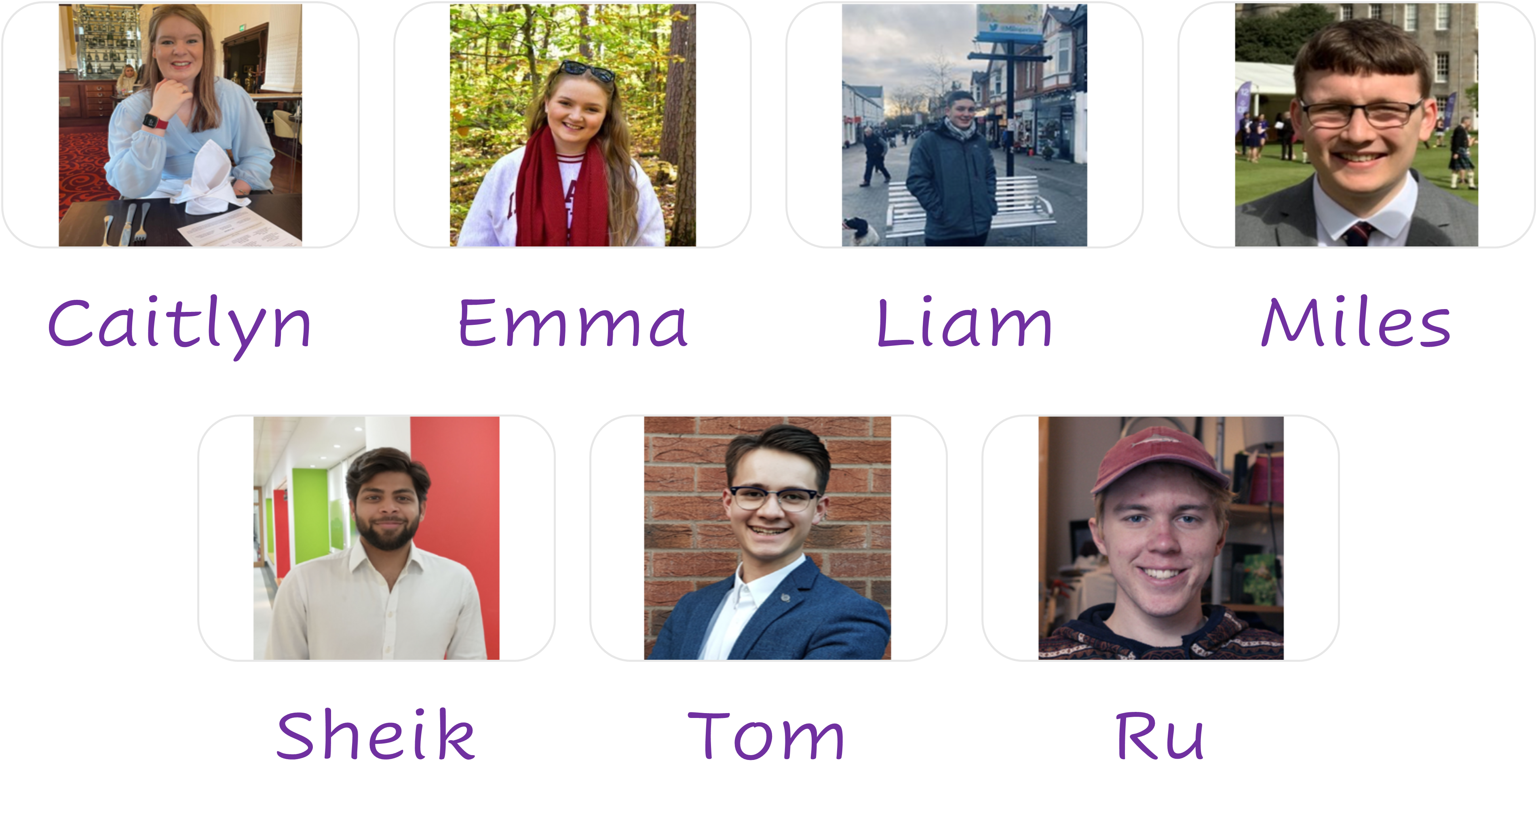
Ask the Societies Exec

Slide 28
AOCB

Slide 29

Thank you!

