Slide 1
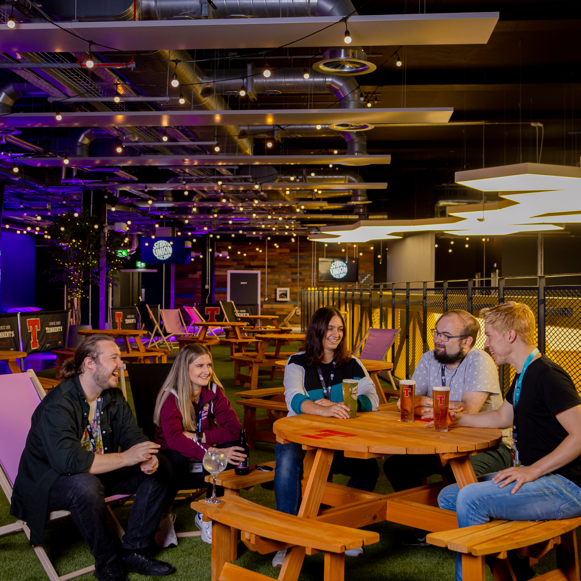
Societies GM1
4th October 2021

Slide 2

Before we begin…
Make sure you have sent your name, DS number and society(ies) that you are representing to Jodie Waite in the Chat section of Zoom

Slide 3

Agenda
Societies Membership
Risk assessments and room bookings
Societies committee training
COY16
Ask the Societies Exec
Q&A

Slide 4
Societies Membership
Four proposed types of society membership and what each type of membership is eligible for and subject to
Reasoning behind this is to provide level of safeguarding for students
Previous requirement is only that 75% of members must be current Strathclyde students and no restriction on who can make up remaining 25%
Proposal removes ability of anyone being able to join a society, even if they have had no connection with Strathclyde or another institution in Glasgow

Slide 5

Strathclyde Student Membership
Society can choose whether to charge a membership fee or not. Should always be encouraged to charge a nominal fee.
All Strathclyde Students are subject to Strath Union policies, code of conduct and disciplinary procedures.
Can hold committee positions.
Can vote in society meetings and AGM’s. Committee members eligible to represent society at General Meetings & AGM’s (each society has one vote)
Can go on overnight trips with society.

Slide 6

Non-Strathclyde Student Membership
Must be charged a membership fee. The amount is at the discretion of the society – should be equal to (if charging a strath student fee) or more than a Strathclyde student membership.
Must belong to another institution and use their University email to register with the society e.g. GCU, City of Glasgow College
Eligibility for the duration of their time at their institution.
They are subject to Strath Union code of conduct and policies. Any breaches of these or complaints received will result in an investigation by Strath Union staff. officers and may result in membership being cancelled and the individual banned from all strath union activities, events and the building. Their own institution will also be informed.
They may not hold committee positions and cannot represent the society or vote at Societies AGM, GM or individual society elections.
They can / cannot go on overnight society trips (TBC)

Slide 7
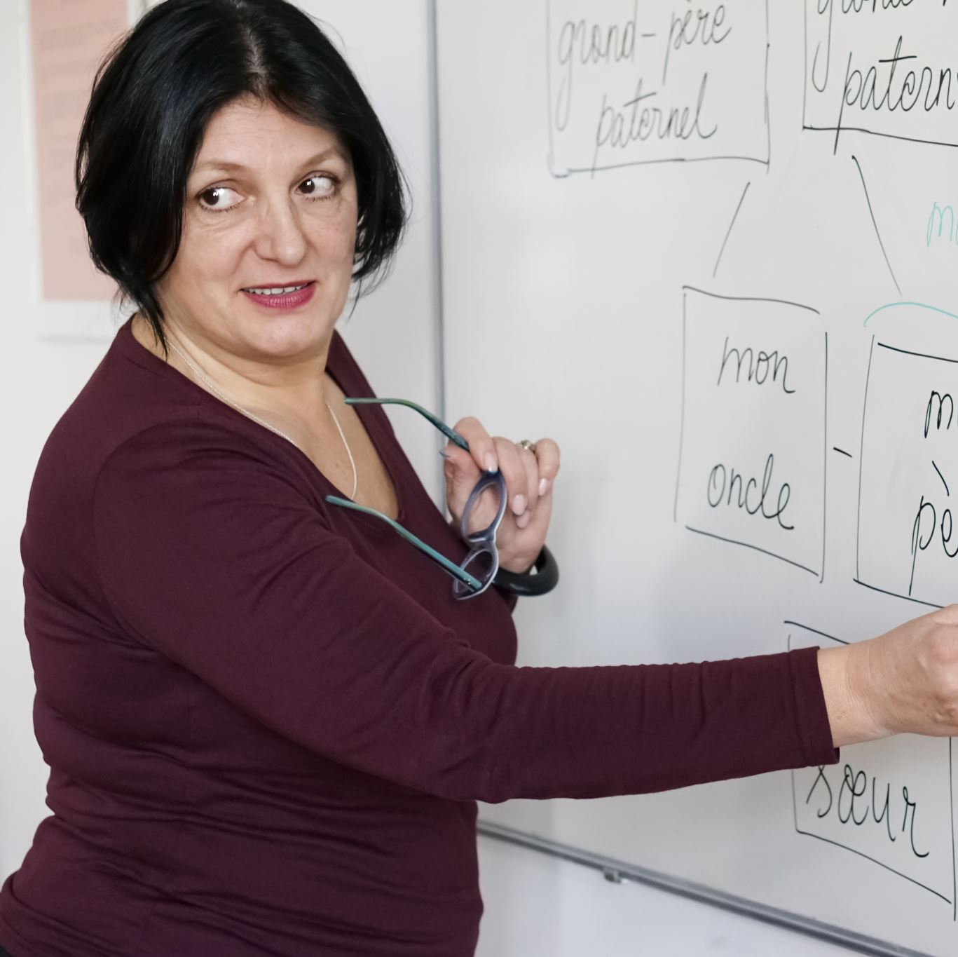
Strathclyde University/Union Staff
Must pay a membership fee. Value of this is at the discretion of the individual society but must be more than a Strathclyde student membership fee.
Anyone with a Union or University employment contract is eligible to join a society for the duration of their employment with Strath Union or Strathclyde University. They must use their @strath email to register for the society.
They cannot hold committee positions or vote in Societies GM, AGM or individual society elections.
They cannot go on overnight society trips but can go on day trips / events.
They are subject to Strath Union code of conduct, all Strath Union and University policies. They are subject to Strath Union / University staff policies / terms of contract and disciplinary procedures.

Slide 8

Alumni Membership
All Alumni members must purchase a Strath Union Alumni Membership (previously Life Membership)
Strath Union Alumni can continue to be an Alumni Member of a society for a maximum of 4 years following graduation or when their student status ended.
All societies must charge a yearly Alumni membership fee and this must be greater than the charge fee for current Strathclyde Students
To be eligible for an Alumni membership you must have been a member of the society in question for the last semester prior to leaving the university.
If an alumni member was on the society committee in the year prior to leaving University they are eligible to be elected the Development Officer on the society committee for a maximum of one year.
They are Ordinary committee members and are unable to vote in society elections, Societies GM or AGM.
Alumni members are subject to Strath Union Code of Conduct and all Strath Union policies. Any complaints made against an Alumni member or breaches of policy or code of conduct will be investigated by Strath Union and may result in membership of the society, and the Union being revoked, banned from the premises and attending any society or Union events.

Slide 9
Risk Assessments & Room Bookings
Huge number of risk assessments and room bookings to process and thank you for your patience while we are working through these
All room bookings involving an activity and external activities require a risk assessment to be submitted.
Regular meetings and meetings on the Terrace will now be covered by the Strath Union risk assessment. These will be issued once the booking has been confirmed.
All room booking requests must be made through our website
University rooms require bookings to be made two weeks in advance
Working through these as quickly as we can and apologise for the delay

Slide 10

Societies Committee Training
Societies committee training is being run on Wednesday 27th October at 2pm – 4pm
Sign up at: https://www.strathunion.com/volunteering/training/
Finance Training will be offered in November once our new finance system is in place

Slide 11

COY16

Slide 12
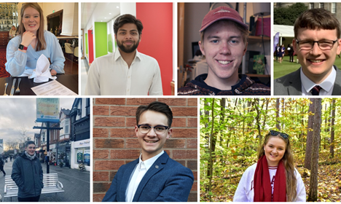
Ask the Societies Exec

Slide 13

Committee Q&A Session
Your chance for:
Any questions on the new building
Any questions on risk assessments
Any questions on room bookings
Any ideas for collaboration

Slide 14
Thank you for coming!

