Slide 1
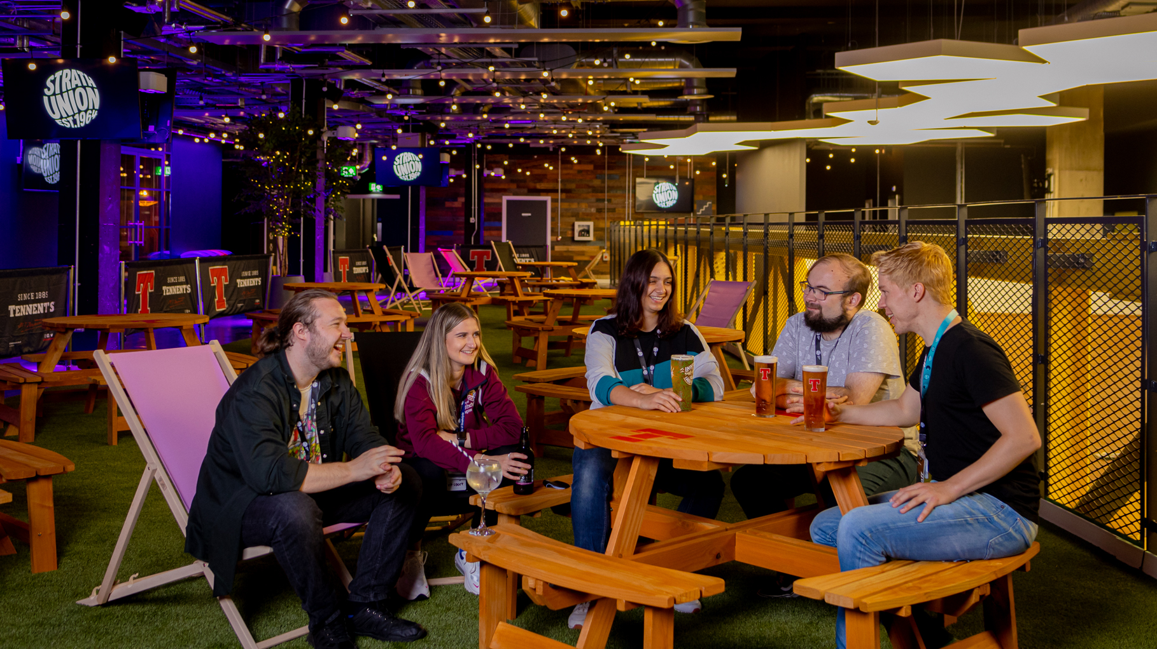
Societies GM2
17th November 2021

Slide 2

Before we begin…
Make sure you have sent your name, DS number and society(ies) that you are representing to Jodie Waite in the Chat section of Zoom

Slide 3
Agenda
University Challenge
Fight for the Night
Centre for Sustainable Development
Societies Membership Proposal
Active and Engaged Opportunities:
Let’s Re-Think Travel Challenge
Donation Drive
Ask Societies Exec
AOCB

Slide 4
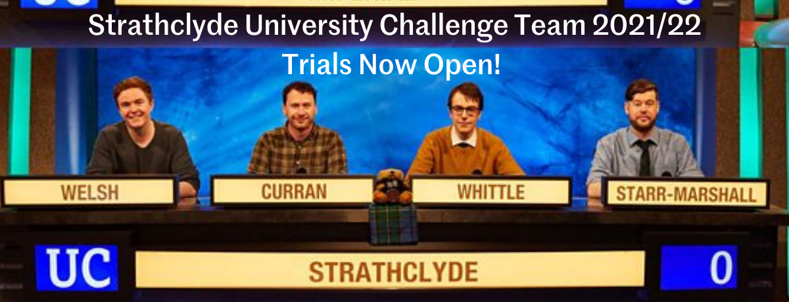
University Challenge Trials

Slide 5
University Challenge Trials
All those zoom quizzes over the past 18 months have been working up to this! No matter what year you are in, or what course you study, every single Strathclyde student has the potential to be on this team and represent your University on the live shows..
Our aim is to put together a team that not only reflects a wide range of knowledge and interests but is representative of our diverse student body in terms of race, gender identity, sexuality, disability, faith, socio-economic background, and more. Don't let anything hold you back from trying out - you might just be on the Strathclyde Team and make it all the way to the finals.
It is really simple to take part in the trial:
  Click here to take you to a google quiz, fill in your personal details and answer as many questions as you can (don't google the answers!)
  The top 10 scorers will be invited to the final selection stage facilitated by our Quiz society and previous contestants on University Challenge
  Auditions for the live shows will take place throughout January & February 2022 and- if successful- the team will be invited down to Salford for the first scheduled recordings 23-27 February (inclusive); subsequent recording dates will be 24-27 March 2022 & 23-26 April 2022. All your expenses will be covered, including travel and accommodation should the team be selected for the live shows.
You have until 9am on Friday 19th November to complete the quiz, and the highest scorers will proceed to the next stage of the selection process.

Slide 6
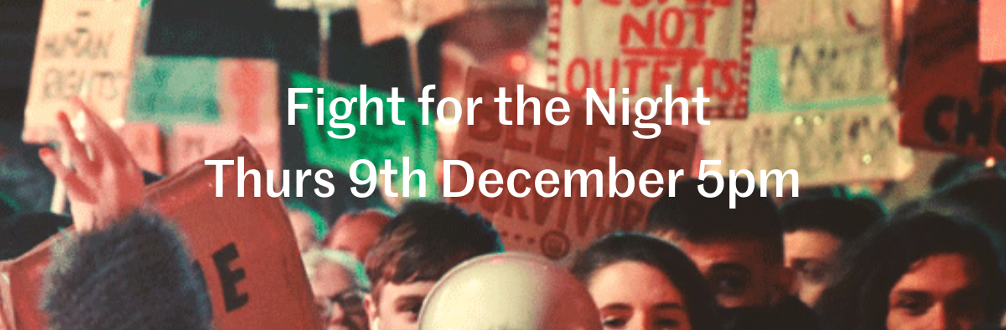
Every year, we march together during 16 Days of Action to demand action to make our streets safer and show solidarity to survivors of rape and sexual assault. After hosting Fight for the Night (at Home) in 2020, we are excited to be heading out to the streets to march.
We are currently awaiting approval from Glasgow City Council for the March - more details will be shared shortly.
If you would like to volunteer as a steward for the event, you can sign up HERE
We believe that, as women, trans and non-binary people and those presenting as female, we have the right to walk the streets at night without the fear of sexual and gendered violence. We want to protest against the stigma surrounding rape and sexual assault, the victim-blaming that goes alongside this and make our thoughts known on the appalling rape conviction rate in Scotland. With the rise in reports of spiking and violence towards women, this is more important than ever.

Slide 7

Shape Strathclyde's brand new MSc in Sustainability!
The Centre for Sustainable Development are in the process of developing a new MSc in Sustainability/Sustainable Development, and would hugely value your input as students. The aim of the MSc is to equip individuals from multidisciplinary backgrounds to become pioneers, equipping them with the relevant skills to become sustainability professionals and to support the transition to a more sustainable world.
If you're interested in assisting with the development of this new MSc, or have some ideas that you'd like to be incorporated into this Postgraduate course, then please get in touch with Louise at: louise.thomson.2020.100@uni.strath.ac.uk

Slide 8

Societies Membership Proposal
Don't forget to feedback your thoughts on the proposal which seeks to define the 25% of non-Strathclyde students who make up society memberships. Make sure to complete this by 31st December 2021 which will allow us to host follow up discussions and present a final draft to our Societies AGM in Semester 2. Tell us your thoughts here.

Slide 9

Opportunities

Slide 10
Let’s Re-Think Travel Challenge
Operation Groundswell, is a Canadian NGO who seek to ‘change the way the world travels’ by running socially conscious ethical travel programmes with community engagement at their centre. They run programmes across the world for young people and are currently running a competition that seeks to ‘Rethink Travel’ by inviting young creatives to share their stories and ideas for collaborative change across the travel industry through their chosen art form, from written stories to digital arts to film and song-writing.
There are a number of prizes on offer from digital media kit to free Operation Groundswell trips! Winners will also have their work posted on Causeartist.com.
What does an inclusive, collaborative, and sustainable industry look like to you? Get the details and submit your story at rethinktravel.net
Share your stories in the #LetsRethinkTravel challenge closing on Friday, December 10th.
@operationgroundswell invites you to #LetsRethinkTravel, a challenge that provides you the platform to bring the travel industry of your dreams to life with a focus on:
Accessibility, diversity and inclusion
Preserving local cultures
Environmental justice

Slide 11

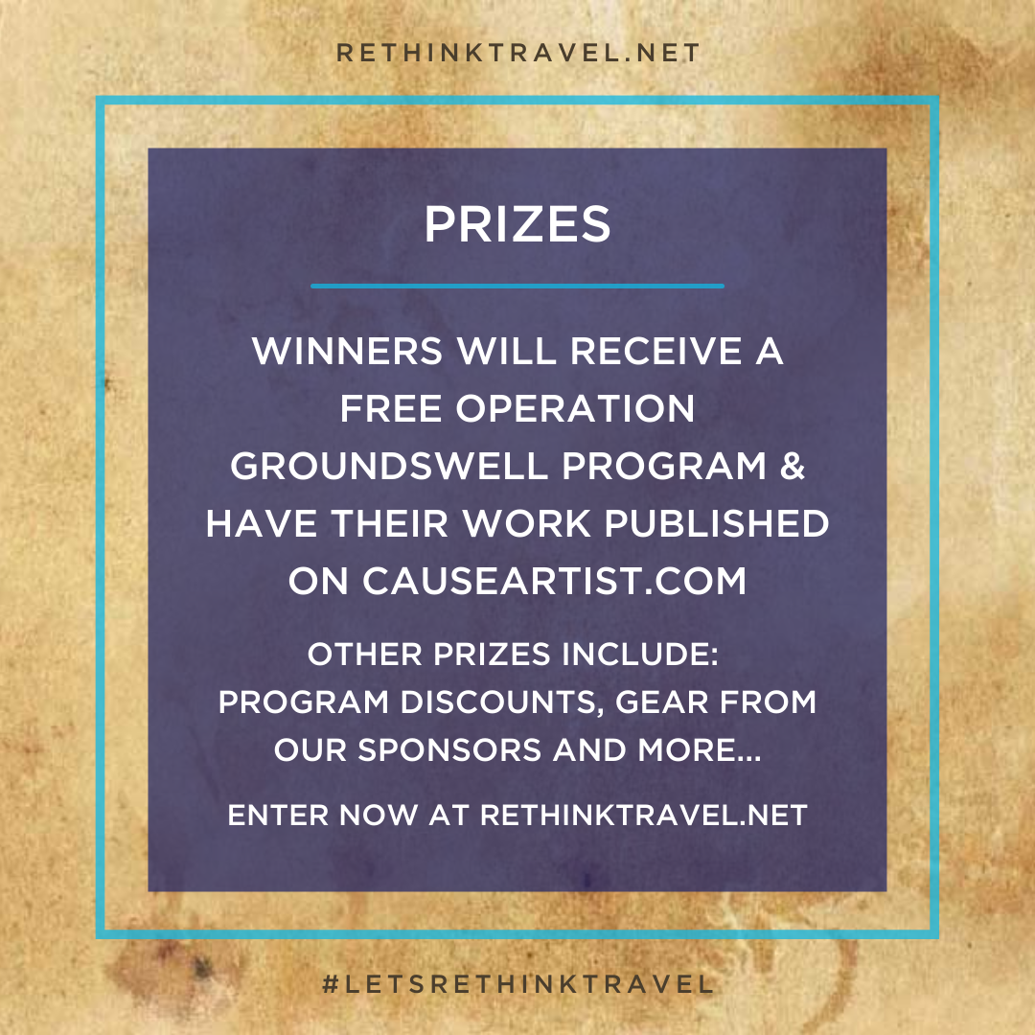
Let’s Re-Think Travel Challenge

Slide 12

Strath Foodbank & Mary's Meals Donation Drive
Societies: Looking for an easy way to meet the Gold criteria of a community/sustainability event? The Foodbank Society and Strath Mary’s Meals have the perfect opportunity!
They're asking societies to collect essential items and donate them at the Elder Room, level 1 of Strath Union, between 22nd-24th November. Your society's donations will help those facing poverty, both in Glasgow and Malawi. To take part all you have to do is:
Read this short info sheet
Tell them your society will take part via this form
Preferably book a slot for your society to drop-off donations (times from 10am-10pm each day) here
Tell members what they should collect and when they should get it by
Come along and drop-off your donations! Members can book their own times but it would be fantastic if you dropped off your society's donations in one go so that they can thank you for your amazing work!
Read all about the event here and feel free to get in touch with strathmarysmeals@gmail.com if you have any questions!
Individuals: you can sign-up to volunteer at the drive here

Slide 13
Ask the Societies Exec
Miles
Caitlyn
Liam
Sheik
Ru
Emma
Tom

Slide 14
AOCB

Slide 15

Thank you!

