Slide 1
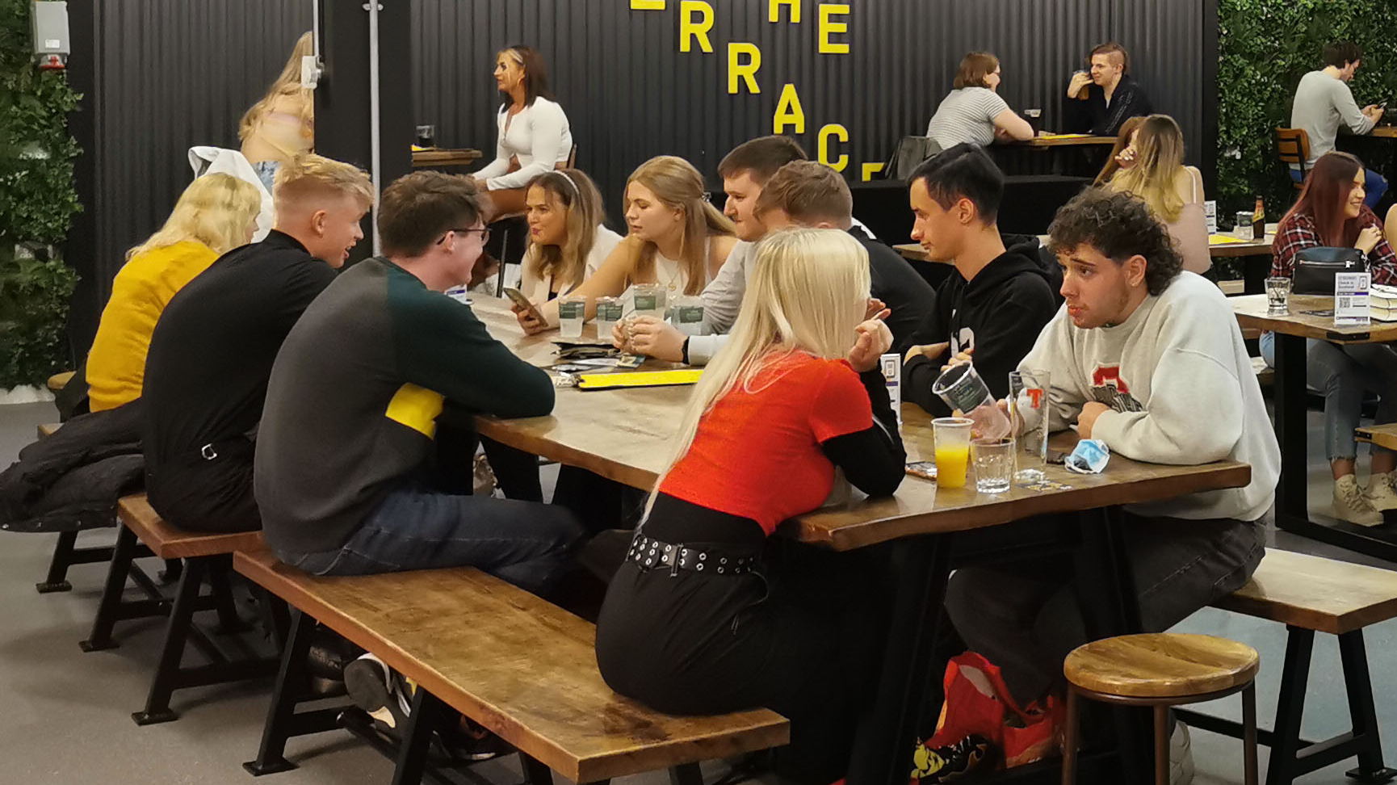
Societies GM 3
3rd February 2022

Slide 2

Before we begin
Please send
Your name;
Your DS username; AND
The society/ies that you are representing
To Jenny Thomson in the chat

Slide 3
Agenda
Society Emails
STAR Awards
Charity Month
Societies Membership Proposal
Finances/Active & Engaged
Societies Exec
AOCB
Sustainability Month
Alumni Fund
Re:Store

Slide 4
Charity Month- February 2022!
Charity month is your society’s chance to win part of £1000 by hosting an event to fundraise for a charity!
So long as your event is within February, you raise £100 or more, and you fill out the nomination form, your society has the chance to win some funding
The prizes are split amongst three categories, with £250 for the winner in each category
  Best Society Collab (£500 split between collaborating societies)
  Most money raised
  Best event

Slide 5





Charity Month
Want to take part, but not sure what charity to support?
Remember you have charity societies who are always looking for support! For example…
Need ideas on fundraising?
Check-out the how-to guide in your society committee resources!
REMEMBER: The union is cashless
Make sure to keep this in mind when planning events- you should use online payment methods (e.g. tickets on the union website), or we are currently setting up an app that will allow you to take payments in-person, please let us know if your society would like to use this method.

Slide 6
Sustainability Month- March 2022
Climate Action group would like to Societies to collaborate with them on sustainability events

Slide 7



STAR Awards!
Thanks to everyone who told us their preference for when the STAR Awards should take place. In-person is definitely the most favoured choice! We will hopefully be able to confirm a date for this soon.
In the meantime, get your nominations in! Nominations close 1 March

Slide 8
Alumni Fund Spring Application Process is now OPEN
The Alumni Fund supports current Strathclyde students by funding student-led projects, clubs, societies and learning opportunities.
The funding aims to enhance your Strathclyde student experience and by supporting vital resources across campus, the Alumni Fund benefits every student.
Applying to the Alumni Fund
Applications are completed online, and you should read the guidelines in advance of starting your application.
Student-led groups and projects can apply for funding if they are affiliated to Strath Student Union or have the endorsement of their academic department
  all Strath Student Union affiliated clubs should seek guidance from Strath Student Union before applying.
The deadline to submit your application is midnight on 10th April 2022. Apply now

Slide 9

Finance training & the new finance system
Please note that the new finance system is NOT yet up & running. Tally is working so hard to get this ready & it was hoped this would be ready this semester, but sadly this has not been possible.
We have not wanted to run treasurer training as we could only train you in the old system, not the new one, which seemed like a waste of your time when we had hoped to introduce the new system soon.
We hope the new finance system will be in place for the new academic year. For now, remember you can access the old finance training here. Please just ignore the finance portals in your admin tools.
More generally, we ask that societies understand that the team is currently doing their best, but as Jodie has now left, they are facing some difficulties as the team re-shuffles and we ask that societies please be patient.

Slide 10

We understand there has been frustration regarding societies being unable to reach silver (& gold) active & engaged.
We have, for this reason, removed the requirement of treasurer training.
You can now update your active and engaged status, as normal, and you should now be able to get to Silver, then Gold, assuming you’ve met all the other criteria.

Slide 11
Society @strath.ac.uk emails
Thank you to the societies who took part in our email pilot and thank you to those who provided feedback.
We are now looking to extend this to all societies!
We hope to have these in place for societies as they re-affiliate in the new academic year.
For those who were part of the pilot: if you haven’t yet filled out the feedback form, you still can, and this feedback will help us in implementing the emails next year.

Slide 12
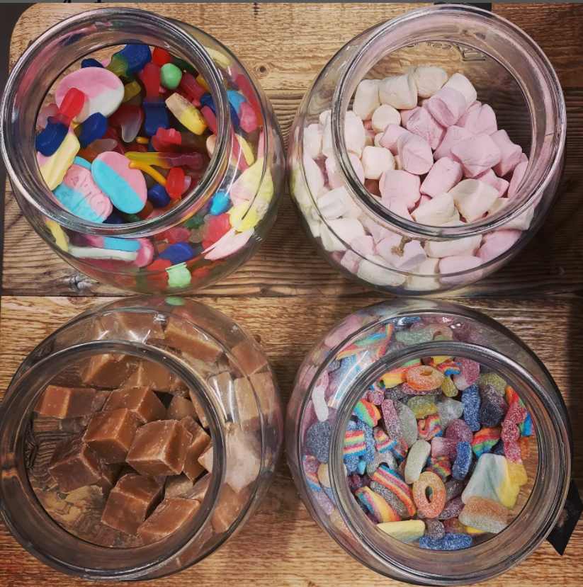
Re:Store pick'n'mix
You can now add vegan pick'n'mix from our own zero waste store to your room bookings!
These will be charged straight to your society account and will be ready to collect from Re:store in time for your booking. Crisps, chocolates or sweets selection at £1 p/p or 500g crisps sharing tin for £9

Slide 13
Societies Membership Proposal
Thank you to everyone who provided feedback on the previous proposal.
We have considered all the feedback we received through the survey and have came up with a new proposal taking these concerns and ideas into account. Some key points include:
Associate memberships are available for alumni and may be renewed annually for an unlimited amount of time, as long as membership is continuous.
Associate memberships are also available to Uni Staff members, students at the Strathclyde Centre for Lifelong Learning, and students at other institutions.
We will make our digital systems for tracking memberships more comprehensive to improve our ability to support societies in keeping their members safe.
We have removed the need for Development Officers to have been members of the Society in their final year at Strathclyde
We will look into disclosure check processes to enable associate members to join overnight trips
Please do let us know if you have any major objections to the new proposal, but it will be going onto Student Parliament in mid-February for students to vote on it and you will be welcomed to take part in discussions there.

Slide 14
Societies Exec
Common questions/issues to be covered first before a Q+A:
  Retrospective grant requests
  Trips
  AGM- run to be on the socs exec!
This semester’s meeting dates (which you can always find here)
  9th February 2022
  23rd February 2022
  9th March 2022
  23rd March 2022
  6th April 2022
  20th April 2022
  4th May 2022
Deadline: 12 noon the day before

Slide 15

Ask the Societies Exec
Ru
Caitlyn
Emma
Liam
Miles
Sheik
Tom

Slide 16
AOCB

Slide 17

Thank you!
There have been increasing numbers of people emailing the wrong email leading to delays and confusion…
Please email strathunion.societies@strath.ac.uk when you need help with your society! ☺

