Slide 1
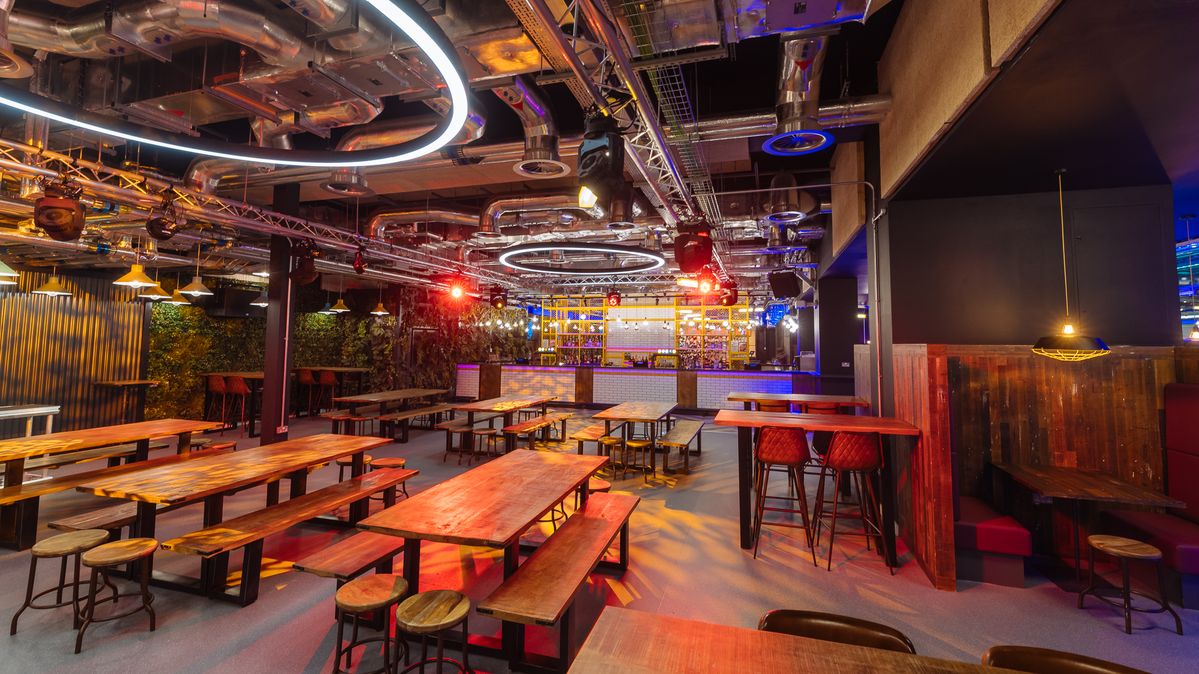

General Meeting
Welcome!

Slide 2

Ice Breaker
Go into groups of 5. Find the “common thing” about you all.

Slide 3

Alumni Fund

Slide 4



Active and Engaged
Society Badges
New and Improved – more prizes!

Slide 5

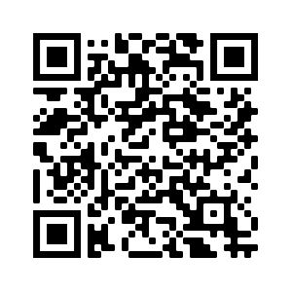
Societies Policy
Policy is being updated. Proposed updates have been sent out. We welcome any feedback online via the survey.

Slide 6
Societies Executive
Budget Update
 | Arts and Culture | General Pot
Total Budget | £15,000 | £40,000
Exec 1 Spend | £375 | £315
Exec 2 Spend | £801.91 | £1540
Exec 3 Spend | £690 | £1540
Remaining Budget | £13,113.09 | £36,605

Slide 7
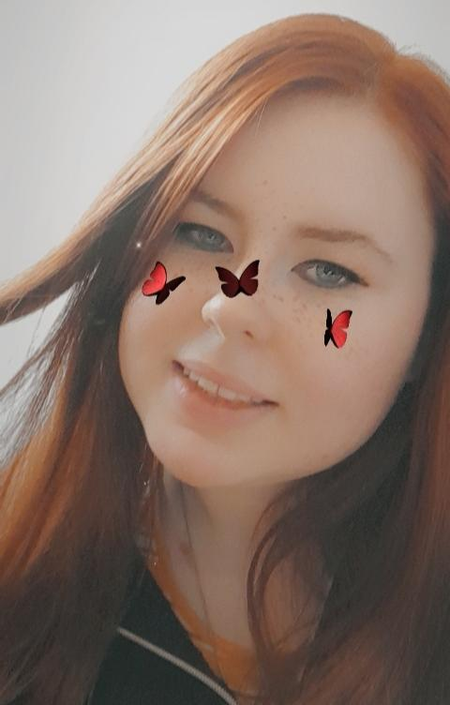
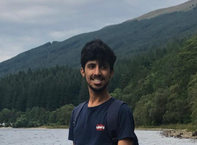
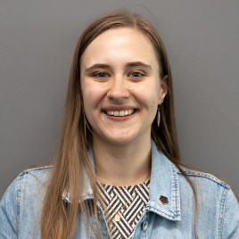
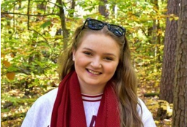
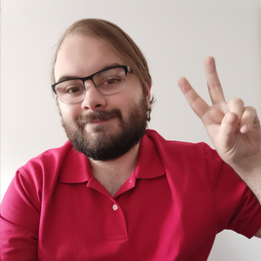
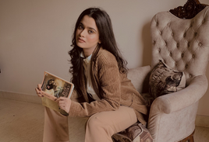
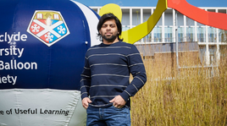
Ask the Societies Executive

Slide 8

App Creative Sessions
October-November 2022

Slide 9

Discount Cards
Coming soon!

Slide 10

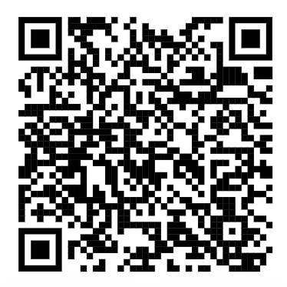
Inclusive Swimming at StrathSport
Scan here to find out more:

Slide 11

Open Day
8th October
Contact societies at:
strathunion.societies@strath.ac.uk

Slide 12
Intersoc Representatives
New way to connect societies.

Slide 13

INTERSOC REPRESENTATIVE
Manifesto Pledge

Slide 14
Why do we get involved in societies?
Building a sense of community
Developing transferable skills
Adjusting to new cultures or environments
Notes:
Speak about the problem:
Separated Societies
Doesn’t foster a community aspect
Fewer opportunities to develop oneself
Lack of collaborative activities

Slide 15
The Purpose of the role…
Training societies how to run events with confidence, providing them with lifelong skills in project management and teamwork.
01
Supporting the community at Strath Students Union in creating a more collaborative atmosphere (especially after the 2-year disruption of the pandemic).
02
Making societies feel as part of the collective of the Union rather than just part of one society.
03

Slide 16
What it would look like…
Facilitating and helping societies plan events/ collaborations
This could be in the form of…
  Charing meetings.
  Checking up on action points.
  Working between categories, not just within (Course Based society working a Hobbies & Interest society).

Slide 17
The Structure
6 Society categories:
    Political & Activism……… Benn
    Hobbies & Interests……… Jamie
    Course Based………………. Sheik
    Faith and Culture………… Shreya
    Community………………… Emma
    Media, Arts & Music……. Haroon

Slide 18
Thanks for listening- any questions?

